Slide 1
Waves

Slide 2
Introduction to waves

Slide 3
Learning Intentions
Define the term mechanical wave.
Compare the terms transverse wave and longitudinal wave.

Slide 4
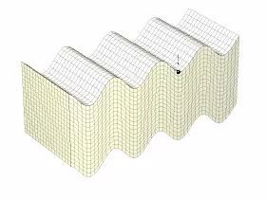
Mechanical Waves
A mechanical wave is defined as a wave that requires a medium to propagate.
Mechanical waves may oscillate the medium or oscillate the pressure within the medium.
This means mechanical waves need particles to travel through, so do not travel through a vacuum.

Slide 5
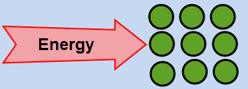
Through a medium
Mechanical waves travel through a medium.
They transfer energy without the whole medium being transported from place to place. Instead, only the particles within the medium vibrate back and forth or oscillate the pressure within the medium.

Slide 6
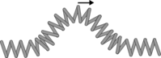

Longitudinal and transverse waves
There are two types of mechanical waves: longitudinal and transverse.
In transverse waves the particles oscillate at right angles to the direction of motion of the wave. Particles in longitudinal waves oscillate parallel to the direction of wave motion.
Transverse waves:
Longitudinal waves:
Sound waves are an example of longitudinal waves. Water waves are a common example of transverse waves.

Slide 7
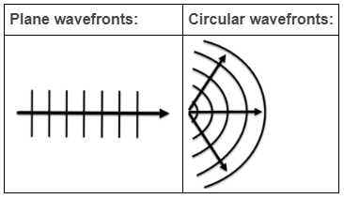
Wavefronts
A wavefront is an imaginary line that connects all points which are reached by the wave in the same time.
A ray is an arrow pointing at right angles to the wavefront and points in the direction of wave propagation.
The model which represents the wave in terms of wavefronts and rays is called the ray model.
There are two types of wavefronts: plane and circular. Circular wavefronts spread out from a point source.

Slide 8
Pulse vs Continuous waves
When only one wavefront is generated, it is called a pulse.
A continuous wave has wavefronts being continuously generated. The wave moves outwards at a constant speed in all directions. As the wavefronts get further away from the wave source, their amplitude decreases because they gradually lose energy to the environment.

Slide 9
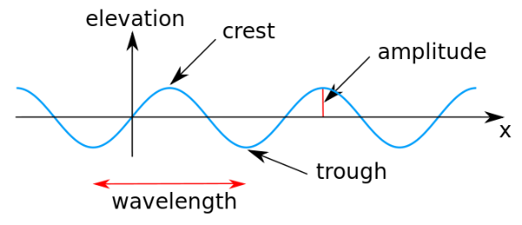
Wave Characteristics
The amplitude of a wave is the maximum displacement of a particle from the mean position. It has the symbol A and SI units of metres (m).
Wavelength is the distance between two successive crests. It has symbol λ (lambda), and is also measured in metres (m).

Slide 10
The frequency of a wave is the number of crests generated per second. It has the symbol f and two acceptable units; Hertz (Hz) or s⁻¹.
The period of a wave is the time it takes for the wave to repeat itself. It has the symbol T and units of seconds (s).
Every wave propagates at a certain speed. This is the rate at which the wave covers distance. It has the symbol v and units of metres per second (ms⁻¹).

Slide 11
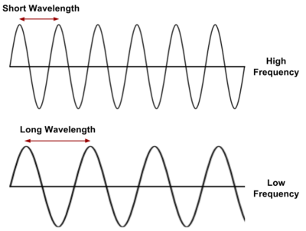
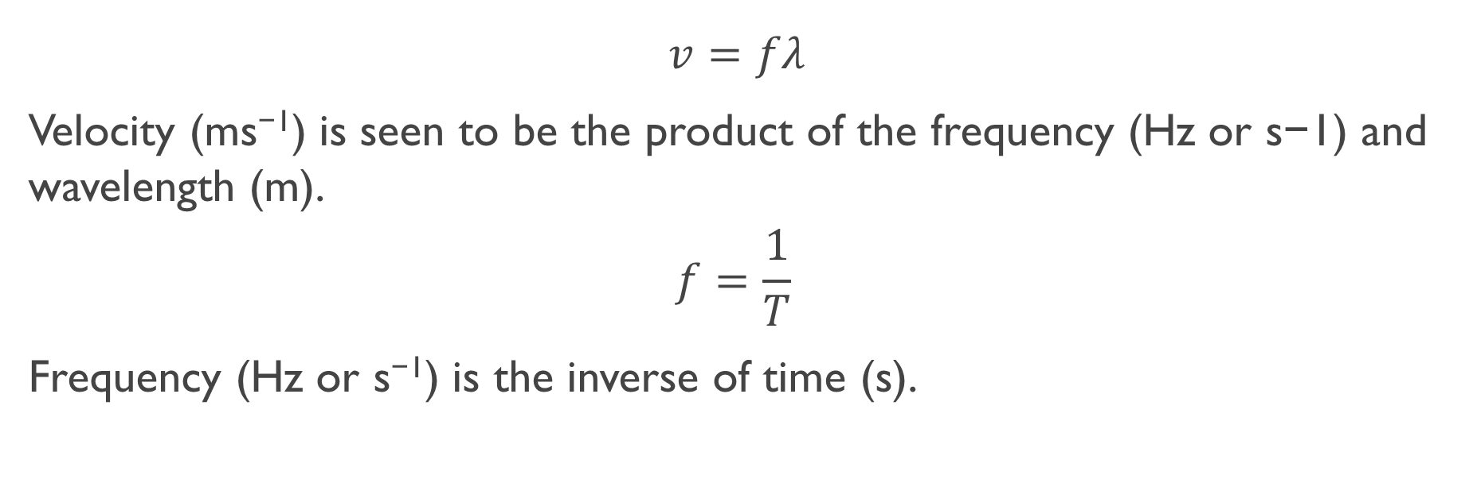
Formulae and wave characteristics
$$v=fλ$$
Velocity (ms⁻¹) is seen to be the product of the frequency (Hz or s−1) and wavelength (m).
$$f=\frac{1}{T}​$$
Frequency (Hz or s⁻¹) is the inverse of time (s).

Slide 12
Wave Behaviours

Slide 13
Learning Intentions
Describe how a sound wave looks like.
Define the terms reflection and refraction.
Recall the factors that affect the speed of sound.
Calculate the speed of sound from the wavelength and frequency of a wave.

Slide 14
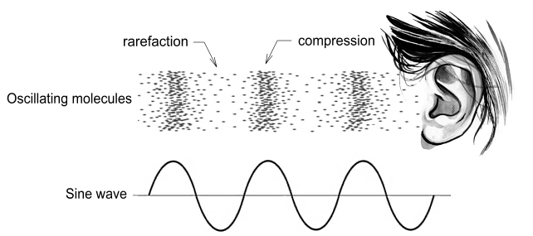
Sound Waves
are longitudinal
amplitude (intensity of compression)relates to volume
frequency relates to pitch
Just like light, sound waves can be transmitted, reflected, refracted or diffracted
The speed of sound depends on the medium it travels through: generally fastest through denser materials/solids

Slide 15
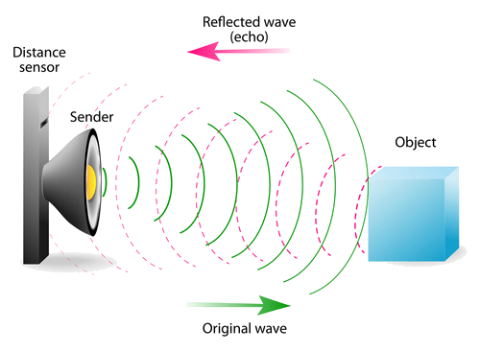
Reflection
Reflection occurs when waves bounce off a surface.
Reflection is defined as when incident waves at a boundary change direction returning into the same medium according to the law of reflection.

Slide 16
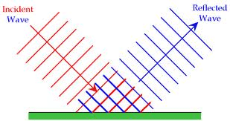
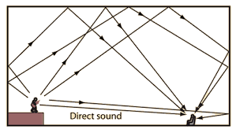
Reflection of Sound
Sound obeys the law of reflection.
Sound can also undergo total internal reflection, such as reverberation or
through stethoscope tubes.

Slide 17
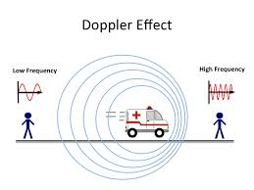
Doppler’s effect
When the source of waves is approaching the receiver, each wave is emitted closer than the previous one.
Since the wavelength decreases, the frequency increases.
When the source of the sound moves away from the receiver, the reverse occurs.

Slide 18
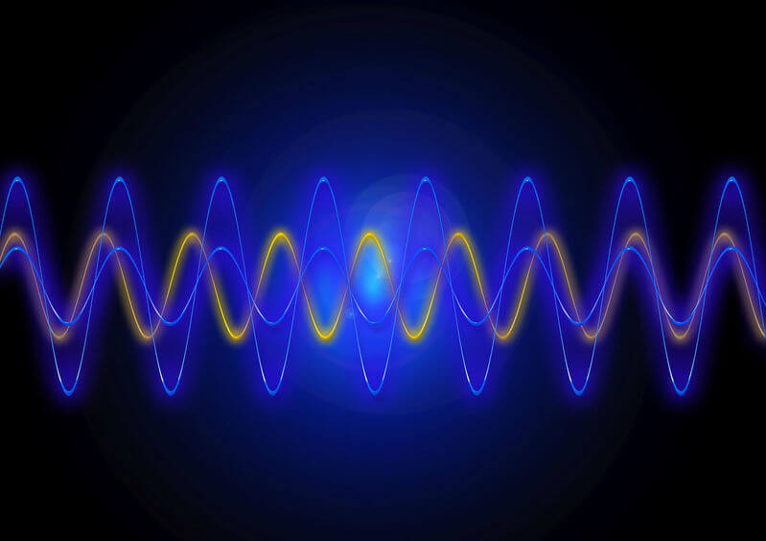
Speed of Sound
The speed of sound is determined by the medium it travels through.
Each medium has a different density and different elastic properties (elasticity). This means that the speed of sound changes depending on what it's travelling through.
For example, sound travels faster through water than air.

Slide 19
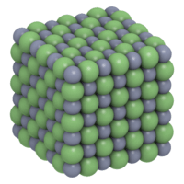
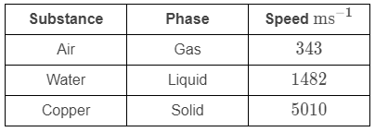
Speed of sound and phases of matter
The phase of matter (e.g. whether it is solid, liquid, or gas) has the largest impact on the elastic properties of the medium.
Sound travels fastest in solids because they have the strongest interactions between particles. Strong interactions mean that particles respond rapidly to collisions, allowing the wave to travel faster.
Sound travels slowest in gases because they have the weakest interactions between particles.

Slide 20

Density of the medium
After phase, density of the medium has the largest effect on the wave speed.
If two media are the same phase but have different densities, sound will travel at different speeds through these two media.
High density in solids results in sound travelling more slowly. This is because the interactions between the neighbouring particles occur more slowly as it requires more energy to move the larger particles. In gases, however, higher density often reflects particles being closer together, so sound often travels faster in denser gases.

Slide 21
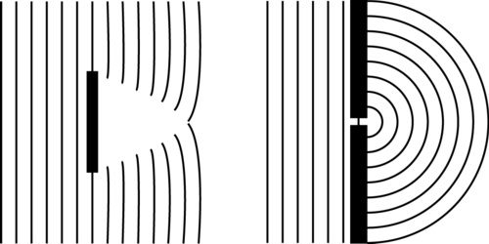
Diffraction of sound waves
Sound waves spread out from the source.
Waves bend around corners or obstacles by diffraction.
Longer wavelengths (lower frequencies) are diffracted more than shorter wavelengths (higher frequencies). (diffraction does not change the speed, frequency or wavelength)

Slide 22
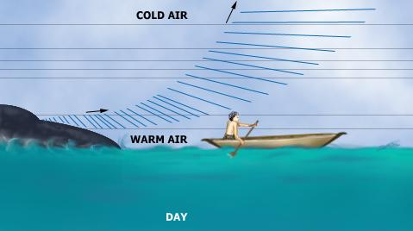
Refraction of sound
Sound waves will refract as they move from one medium to another. The frequency does not change, but the wavelength will change as the wave’s speed slows down or speeds up.

Slide 23
Waves & Mediums

Slide 24
Learning Intentions
Define the terms diffraction and superposition.
Apply the principle of superposition to determine the resultant amplitude of two simple waves.
Explain constructive interference and destructive interference of two simple waves.
Explain the formation of standing waves in terms of superposition with reference to constructive and destructive interference, and nodes and antinodes.

Slide 25
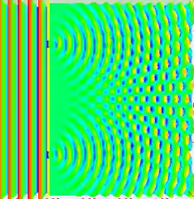
More than One wave
So far, you have been learning about a single wave and its properties.
But have you thought about what happens if there is more than one wave?
What happens if there are 2 sources of waves, such as 2 speakers?
How will the 2 waves interact with each other?

Slide 26
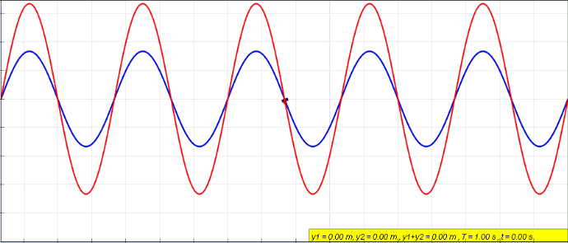
Superposition
Superposition refers to the process that happens when two waves meet.
The waves pass through each other.
As they do so, their amplitudes are combined.
If the waves match, such as both having crests, or both having troughs, the amplitudes add together. This is known as constructive interference. The waves are said to be in phase.
If the waves do not match, and have a crest and a trough, the amplitudes are added, but one is negative, so in effect they are subtracted. The overall amplitude decreases. This is known as destructive interference.

Slide 27
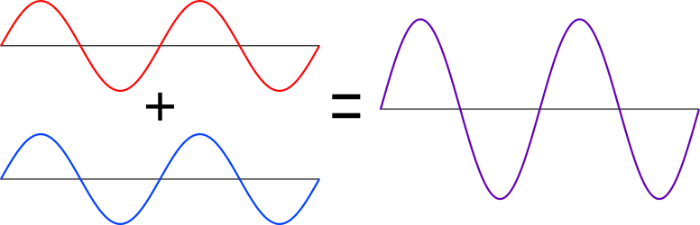
Calculating resultant wave
In summary, to calculate the resultant wave when two waves pass each other, simply add the amplitudes.
Superposition is defined as when two or more waves overlap in space, the resultant wave is the algebraic sum of the individual waves.
Crests are considered positive and troughs negative.

Slide 28
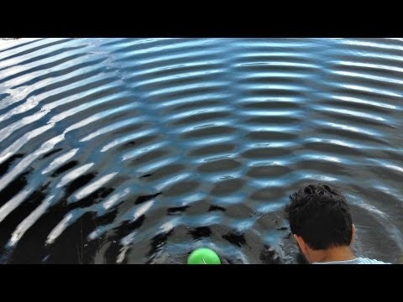
interference
Interference is what we see when waves from two sources superimpose.

Slide 29
Constructive interference
Constructive interference is defined as the interference of two or more waves of the same, or almost the same, frequency and in phase with each other, superposing to produce an observable pattern in intensity.
Simply, it is when the waves interfere to make a larger wave, such as when a crest meets a crest.

Slide 30
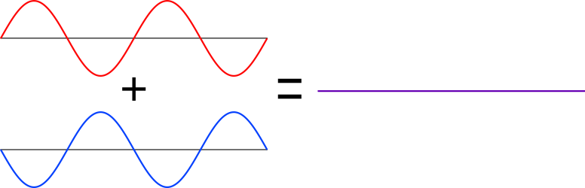
Destructive interference
Destructive interference is defined as the interference of two or more waves of the same, or almost the same frequency and 180∘ out of phase with each other, superposing to produce a resultant wave with reduced amplitude.
In this case, the waves interfere to make a smaller wave (or no wave), with a crest meeting a trough.

Slide 31
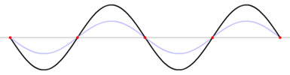
Standing wave
When two waves are travelling at the same frequency, through the same medium, in opposite directions, a wave pattern can form known as a standing wave.
For example, if a rope is fixed at one end and a wave is sent along the rope from the other end, when it reaches the fixed end it will reflect and bounce back. The reflected wave causes interference with the first moving wave and sets up a standing wave.

Slide 32
NOdes
In a standing wave, there are points that do not move. This is where there is perfect destructive interference. These points are known as nodes.
Here the nodes are shown as red dots.
A node is defined as point in a medium that is not displaced as a wave is propagated through it.

Slide 33
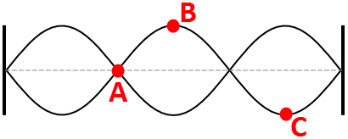
Antinodes
An antinode is defined as the midway point between each pair of nodes where there is maximum amplitude of vibration.
When you look at a standing wave, this is seen as the point that moves furthest up and down.
On this image, A labels a node, whilst B and C label antinodes.

Slide 34
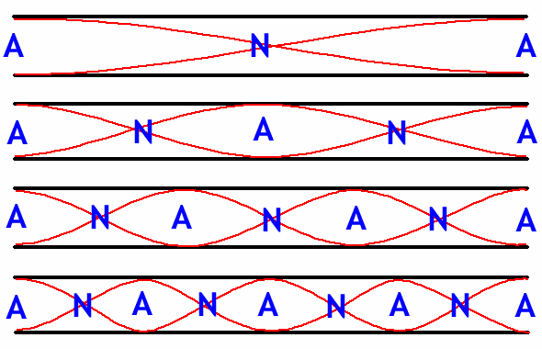
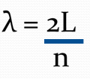
Standing waves in open pipes
Waves change phase when they reach the end of an open pipe, creating maximum amplification. The standing wave starts at the antinode.

Slide 35
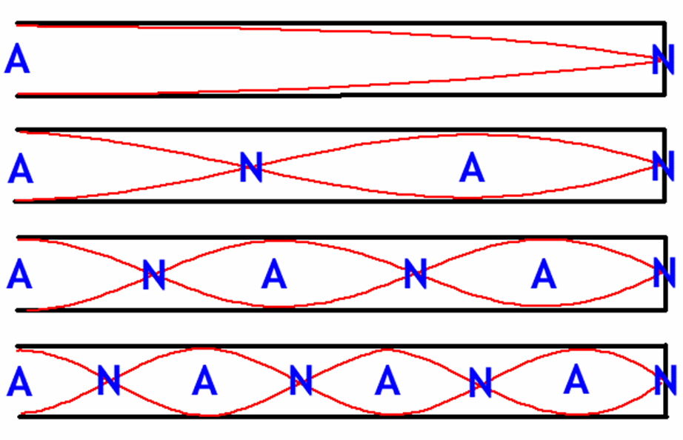
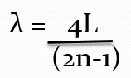
Standing waves in closed pipes
Waves do not change phase when they reach a closed end of a pipe, causing maximum cancellation (there can be no displacement of air at the end of a closed pipe) The antinode occurs at the open end and the node occurs at the closed end.

Slide 36
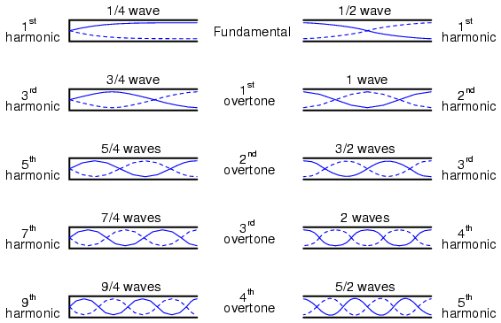
Closed Open

Slide 37
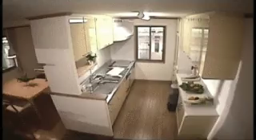
Earthquakes
An earthquake is a sudden release of energy from under the ground.
That energy travels through the ground as distortions called seismic waves. These waves cause shaking; the more energy is released, the stronger the shaking!
Detecting and recording seismic waves allows geologists to study the earthquakes that created them. Understanding them is important for science as well as safety.

Slide 38
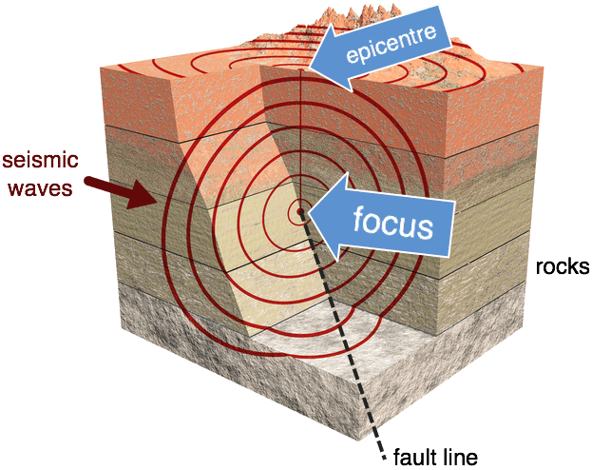
Focus and Epicentre
Seismic waves travel in all directions from a point called the focus.
Sometimes the focus is also referred to as the hypocentre of an earthquake. It's the centre of the shaking!
The point on the Earth's surface directly above the focus is known as the epicentre. From a bird's eye view, seismic waves appear to move in circles out from this point.

Slide 39
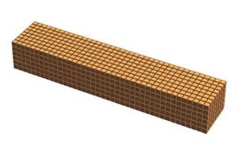
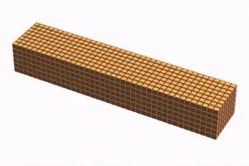
Seismic waves
Seismic waves come in two main types: P-waves and S-waves.
P-waves are longitudinal, like sound waves. As they pass through a material, they cause that material to stretch and squash repeatedly, like an accordion.
S-waves are transverse, like ripples on water. They cause solid materials to wiggle from side to side, or up and down.
P-wave
S-wave

Slide 40
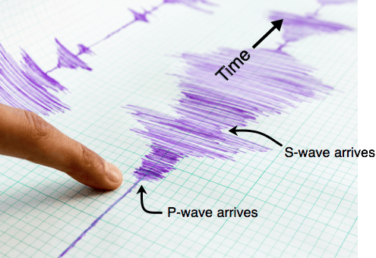
Speed of P & S -waves
P-waves travel through the Earth faster than S-waves.
This means that P-waves are recorded by seismometers before the S-waves are.
It also means P-waves can warn us of incoming S-waves, which tend to do more damage to structures on the ground. The arrival of the P-waves a few seconds earlier gives people time to shelter under their desks or in doorways.

Slide 41
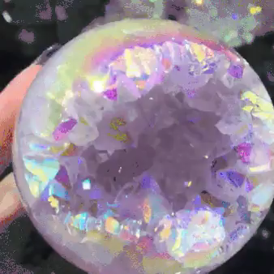
Ultrasound
Ultrasound is sound at frequencies above 20,000 Hz, which is above human hearing range. In Latin, ultra means 'beyond'.
Artificial ultrasounds are produced by vibrating quartz crystals, which are induced to vibrate by high-frequency alternating currents.
The uses of ultrasound waves or ultrasonics are increasing very rapidly, especially in the medical profession. Reflection and refraction of ultrasound waves are used to see unborn babies, tumours and body organs.

Slide 42
Wave properties

Slide 43
Learning Intentions

Slide 44
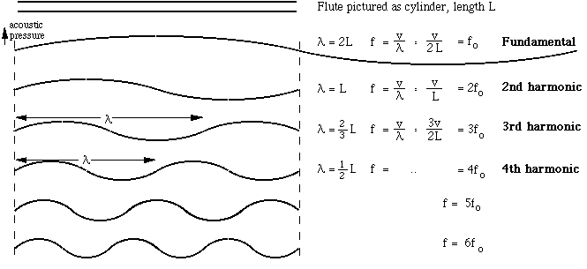
Standing Harmonics

Slide 45
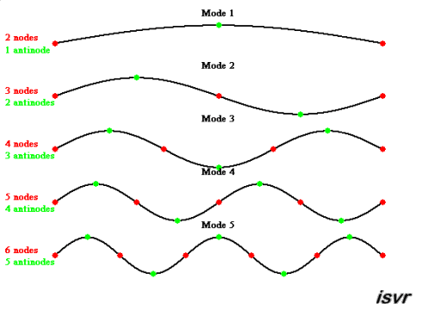

Slide 46
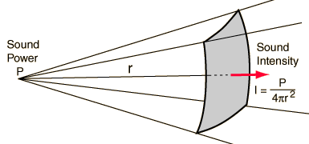
Measuring Sound
Intensity is the amount of energy transported by a sound wave per unit of time across a unit area perpendicular to the direction of the direction of wave propagation, in Watts per square metre, W m^{-2.}
Intensity depends on amplitude and frequency, and decreases with distance from the sound source as the sound spreads over a larger area.

Slide 47
Loudness
Is the measurable sensation of sound.
Loudness relates to intensity, but the relationship is not linear; for a sound to seem twice as loud it must be ten times the intensity.
Ears are not equally sensitive to all frequencies; high frequency sounds may not seem as loud as low frequency sounds of the same intensity.

Slide 48
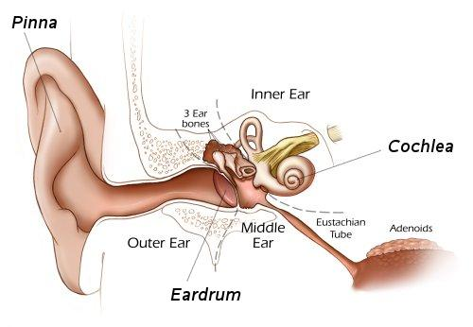
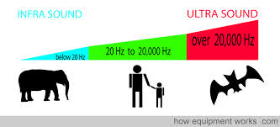
Pitch
Frequency determines pitch, or how high or low a sound is.
Human ears can detect sound from 20 Hz (low) to 20 000 Hz (high)

Slide 49
Introduction to light

Slide 50
Learning Intentions

Slide 51
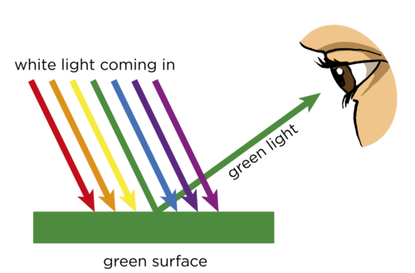
Nature of Light

Slide 52
What is Light?
Light is usually described as being both particle-like (due to photoelectric effect) and wave-like (Young’s double slit experiment) in its behaviour. However, there are three models used to explain it.
Ray model.
Wave model.
Photon (particle) model.

Slide 53
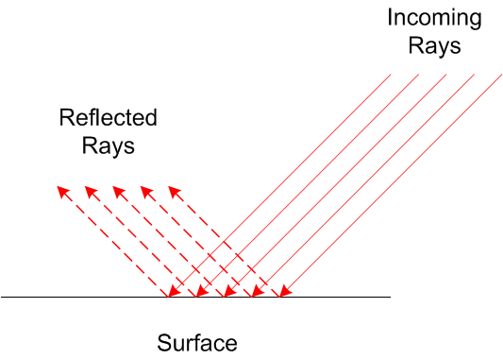
Ray model
Straight line.
Changes directions when interacting with materials.

Slide 54
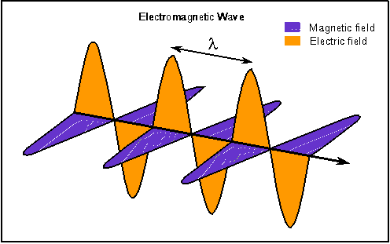
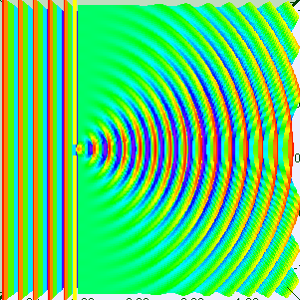
Wave Model
Light is treated as an electromagnetic wave in a vacuum or a medium.
Used to model interference and diffraction.

Slide 55
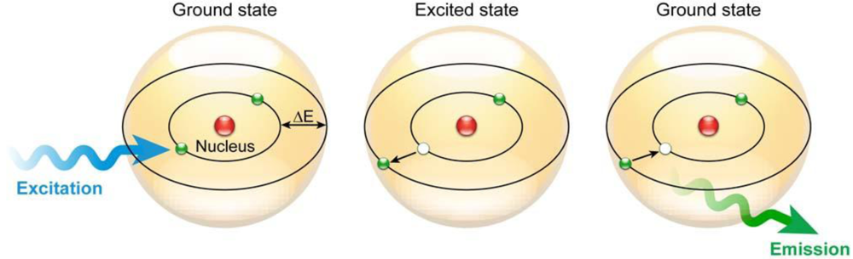
Photon model
Photons act as packets of particles that allow interaction with atoms.

Slide 56
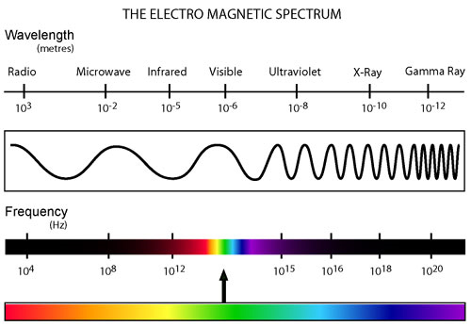
Family of Electromagnetic radiation

Slide 57
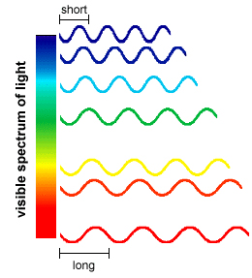
Light- Part of the electromagnetic radiation
Light is part of the electromagnetic family, each with its unique wavelength and corresponding frequency. All have the same velocity, known as the speed of light:
c = 3.00 x 10⁸ ms⁻¹.
Within the spectrum of light radiation the wavelength is varying.

Slide 58
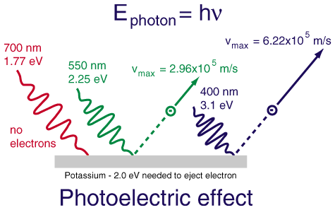
Particle-like properties
The photoelectric principle was demonstrated to show that when light shines on a piece of metal, depending on the type of metal and the frequency of light, then this could produce a current (the movement of electrons).

Slide 59
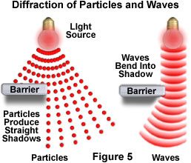
Wave-Like Properties
The fact that light is able to “bend” around obstacles, which is a property of transverse waves, shows light to have wave-like properties.
This phenomenon is known as diffraction.

Slide 60
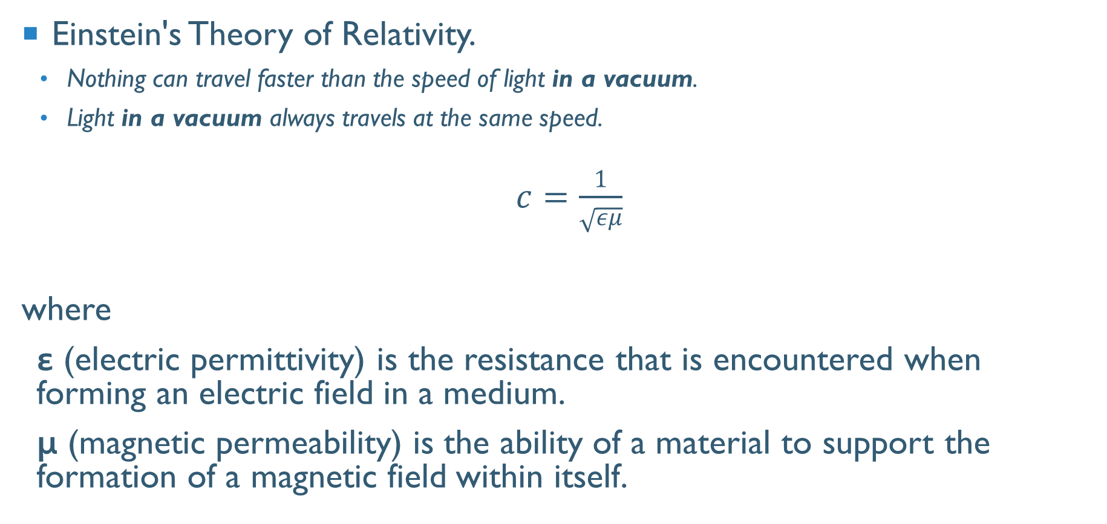
Speed of light in different mediums
Einstein's Theory of Relativity.
Nothing can travel faster than the speed of light in a vacuum.
Light in a vacuum always travels at the same speed.
$c=\frac{1}{\sqrt{εμ}}$
where
ε (electric permittivity) is the resistance that is encountered when forming an electric field in a medium.
μ (magnetic permeability) is the ability of a material to support the formation of a magnetic field within itself.

Slide 61
Wave Behaviours

Slide 62
Learning Intentions

Slide 63

Reflection
When the wave does not pass through the solid barrier it encounters. The light ray that hits the mirror is called the incident ray. The light ray that bounces off the mirror is called the reflected ray.
Law of reflection
Angle of incidence (θ_{i}) = Angle of reflection (θ_{r})
Incidence ray and reflected ray are on the opposite sides of the normal.

Slide 64
The Reflected image
The image appears to be the same distance behind the mirror as the real object is in front of it. This is because the brain thinks that light travels in straight lines without changing direction.
The image is called virtual because the light rays (shown as dotted lines) never really go there (compare this with a real object (image)).
The virtual image in a mirror is the same size as the object but with left and right reversed.

Slide 65

Refraction
Refraction is a phenomenon that often occurs when waves travel from a medium with a given refractive index to a medium with another at an oblique angle.
At the boundary between the media, the wave's phase velocity is altered, usually causing a change in direction.
Its wavelength increases or decreases but its frequency remains constant.

Slide 66

Refraction defined
Refraction is the bending of a wave when it enters a medium where its speed is different.
The refraction of light when it passes from a “less dense” medium to a “more dense” medium bends the light ray toward the normal to the boundary between the two media. The amount of bending depends on the “Indices of Refraction” of the two media and is described quantitatively by Snell's Law.
Index of Refraction, n₁
Index of Refraction, n₂
Angle of Refraction, r
n₁ × sin i = n₂ × sin r

Slide 67

Laws of refraction
A change in medium must occur.
The light wave does not enter the new medium to the normal.
The incidence ray, the normal and refracted ray are all coplanar.
F, A, L, I, C are coplanar
G, E, O, B are coplanar
Exist on the one plane

Slide 68

Snell’s law
The incidence ray, the normal and refracted ray are all coplanar.
A change in medium must occur.
The light wave does not enter the new medium to the normal.
$$\frac{\sin{i}}{\sin{r}}= \frac{v_{1}}{v_{2}}= \frac{λ_{1}}{λ_{2}}$$

Slide 69
Refractive index
Refrangibility is the measure of refraction when light passes from a vacuum to a medium.
The refractive index for a vacuum is 1.00
Material | Refractive Index
Air | 1.0003
Water | 1.3330
Glass (crown) | 1.5200
Diamond | 2.4170
Refractive index also helps determine the speed of light in a given medium.

Slide 70

Total internal refraction
Angle of Incidence > Critical Angle, hence no Refraction

Slide 71

Dispersion
Remember in refraction the frequency remains constant.
Dispersion is the change of index of refraction with respects to the wavelength.
Generally the index decreases as wavelength increases; blue light traveling more slowly in the material than red light causes it to refract more (move more towards the normal).

Slide 72


Lenses
Convex Concave
Converge Diverge

Slide 73


mirror
Concave Convex
Converge Diverge

Slide 74

Ray diagrams
Any ray that passes through the optical centre does not bend
Any ray parallel to the principal axis refracts to pass through the focal point
Any ray that passes through the focal point will be refracted to parallel to the principal axis

Slide 75
Images in a convex lens
Real or virtual
Enlarged or diminished
Upright or inverted
No image

Slide 76
Thin Lens Equation
1 + 1 = 1 .
u v f
M = -h_{i} = -v . +h_{o} u
Variable | Positive | Negative
u | Always | Never
v | Real Image | Virtual Image
h_{o} | Upwards | Downwards
h_{i} | Upwards | Downwards
f | Converging Lens | Diverging Lens
M | Upright | Inverted

Slide 77

Diffraction defined
Diffraction is the slight bending of light as it passes around the edge of an object or through a slit.
The amount of bending depends on the relative size of the wavelength of light to the size of the opening.

Slide 78
Diffraction angle
θ = λ
w
λ
θ
w

Slide 79


Single wave intensity
The diffraction pattern, above, is taken with a laser and a narrow single slit.

Slide 80


Double wave intensity
The diffraction pattern, produced more regions of high intensity within the same region compared to single slit.

Slide 81

Effectively the Double Slit Intensity graph is the superposition of two Single Slit Intensity graphs set out of phase to one another. Note here that the single and double slit intensity graphs are draw to be absolute.

Slide 82

Path Difference
From the central bright point (O) to the first bright fringe is a wavelength. To find that wavelength. Use the formula; Δx = λ L . d

Slide 83
Δx = λ L . d
d – the distance between the slits (m)
λ – wavelength (m)
L – length between slits and screen (m)
Δx – distance between point “O” and the first fringe (m) or the distance between the two bright fringes or dark fringes (m).

